Slide 1
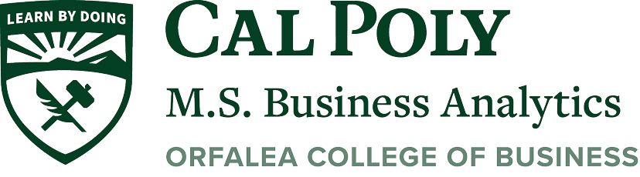
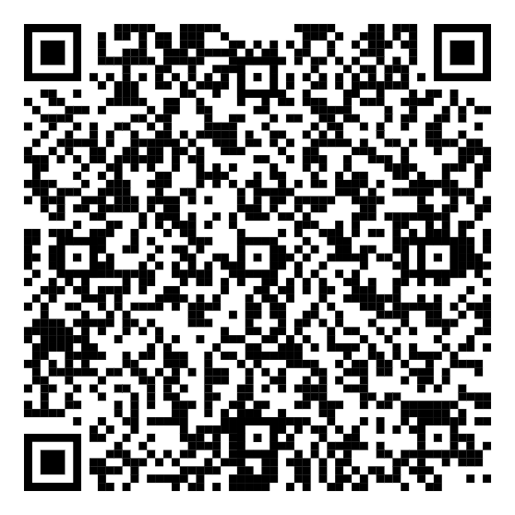
Cal Poly MSBA
Information Session
Dr. Brennan Davis
Director, MSBA Program
Let us know you
attended this
MSBA Info Session
by scanning the
QR Code with
phone’s camera

Slide 2
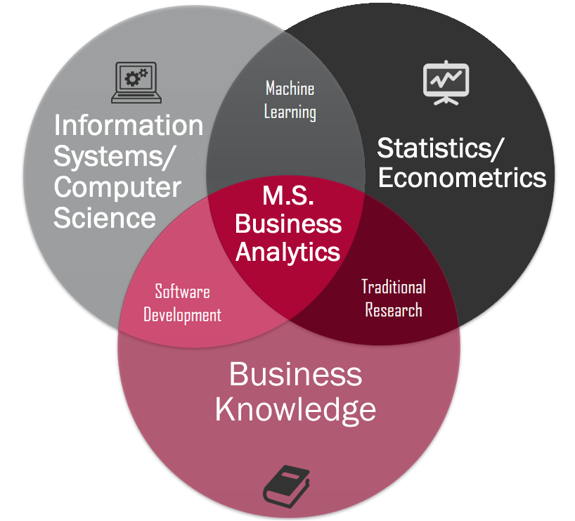
What is Business Analytics?

Slide 3
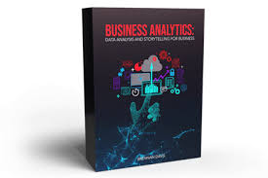
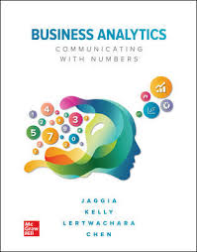
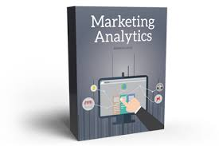
Cal Poly’s Business Analytics Program
Trendsetters:
One of the first programs in the world.
Amazing Professors:
5 Business Analytics authors of 5 textbooks.
Brennan Davis has three textbooks: Stukent’s Business Analytics, Stukent’s Marketing Analytics, and Pearson’s Data Science for All. Sanjiv Jaggia, Kevin Lertwachara and Leida Chen have McGraw-Hill’s Business Analytics. These are used all over the world and Cal Poly MSBA students benefit from them teaching their classes.

Slide 4
Current MSBA Cohort
Frequent Undergraduate Degrees
Business: Accounting, Finance, Information Systems & Marketing
Math/Statistics
Engineering
Economics
Computer Science
Psychology
Animal Science
Political Science
Sociology and Geography
Students are welcome from all over campus!

Slide 5
Current MSBA Cohort
Average GPA: 3.5

Slide 6
MSBA Curriculum
Intersession
Statistics and Probability
Marketing Analytics
Career Development
Fall
Econometrics
Machine Learning
Data Management
Data Mining and Analytics
Career Development
Spring
Collaborative Industry Projects
Career Development
AI for Business Analytics
Electives

Slide 7
MSBA Curriculum
Past Electives
Cloud Computing for AI
AI for Business Analytics
Advanced Machine Learning
Finance Analytics
Finance Time-Series
People Analytics
Data Visualization and Communication

Slide 8
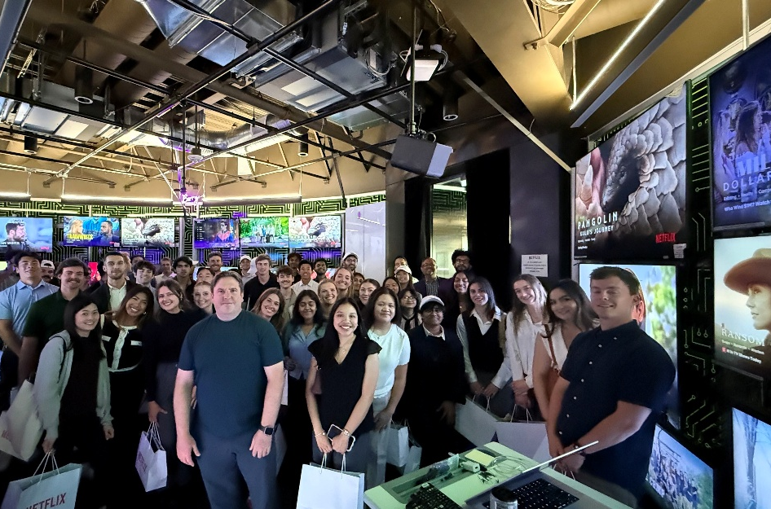
Cal Poly’s Student Development
We have a dedicated Career Advisor – Travis Raynaud
We hold monthly Roundtables with Industry led by a Google Principles, helping students network with dozen of professional each month
Or annual February Analytics Forum brings on campus for networking our Business Analytics Advisory board : https://orfalea.calpoly.edu/graduate-programs/m-s-business-analytics-advisory-board
Overnight
Corporate Tour. In the past, we went to Oracel, Netflix and google

Slide 9
AI for Business Analytics
Our MSBA program integrates AI by leveraging it on the back end through cloud computing in the following ways:
Tokens & embeddings - cost, context, similarity
Retrieval-augmented generation (RAG) - data-grounded answers
APIs & integrations - model-powered apps
Agents - tool-using automation
Evaluation - metrics, A/B tests, monitoring
Responsible AI - privacy, fairness, governance
Vector databases & semantic search - fast, relevant retrieval
AI-assisted data storytelling & NLG - concise narratives from data
Causal inference - experiments and uplift-driven decisions
Time series with ML & GenAI - forecasting and anomaly detection
MLOps & LLMOps - deployment, monitoring, governance at scale
Model Context Protocol (MCP)

Slide 10
Collaborative Industry Projects
Students work on real-world data projects
Professors act as technical advisors to the students
Recent clients
  Netflix
  Engie
  AT&T
  Salesforce
  Seattle Seahawks
  Claritas
  Oracle

Slide 11
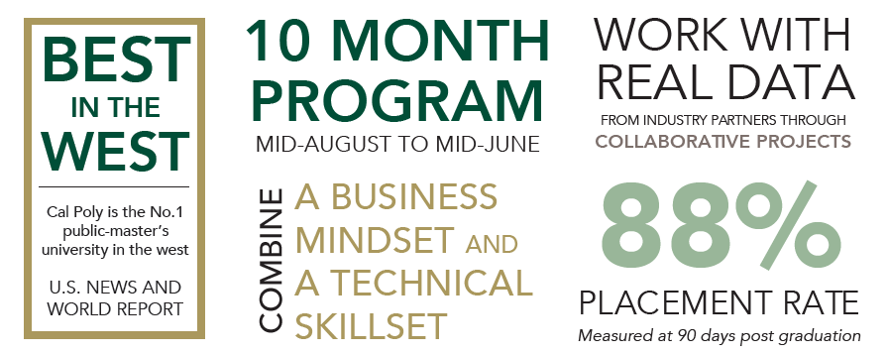
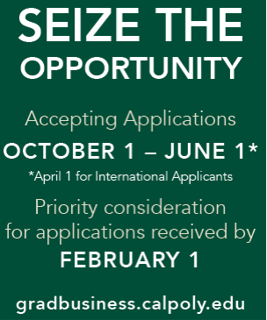
Cal Poly’s Business Analytics Program
Mid-July to Mid-May
October 1 – May 1
April 1 for international
public & private masters university
2025 MSBA Graduate Salary Interquartile Range:
$85,000 – $101,750
Average MSBA alumni salary after two or more years: $145,667*

Slide 12




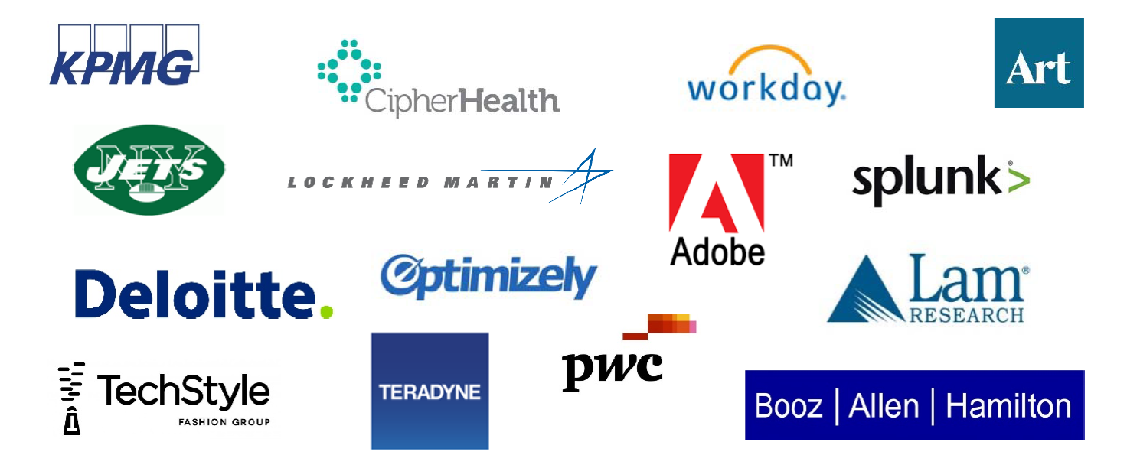
Firms that Hire Cal Poly MSBA Graduates

Slide 13
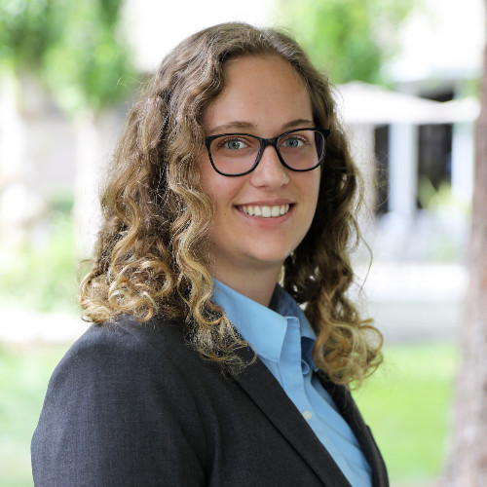
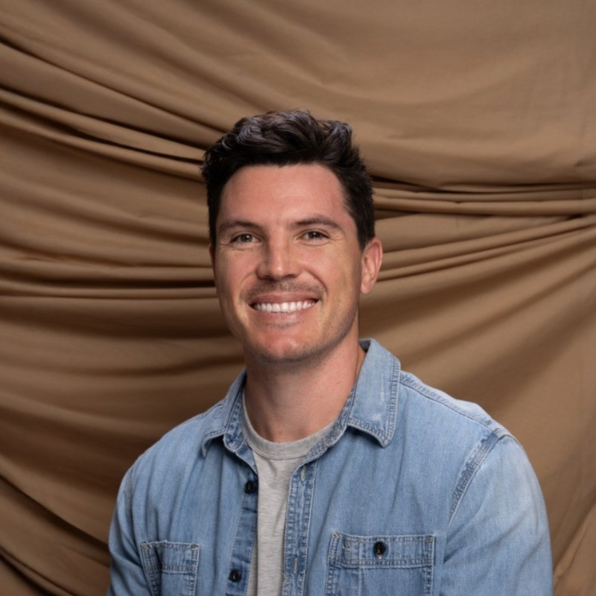
People
Izzy Kamrath –
Principal Business Analyst @ AT&T
Kevin Louther –
Product Analytics & Data Strategy Lead for AI Products @ Adobe
Notes:
Marketing Analytics at Neustar
Consultant for Booz Allen
Sport Analytics at New York Jets (NFL)
Data Science at Story Fit

Slide 14
 | MSBA | MSQE
Focus | Application | Theory
Prerequisites | 2 statistics + calculus | 2 calculus + statistics
Job placement | corporations, technology firms, and consulting firms interested in hiring business analytics professionals | PhD for academia; governmental organizations and firms interested in hiring economists
Inter-disciplinarity | Faculty from Statistics, Computing, Information Systems, Marketing, Management, Economics, and Finance | Faculty from Economics
Culminating Experience | Collaborative Industry Projects | Comprehensive Exam

